Slide 1
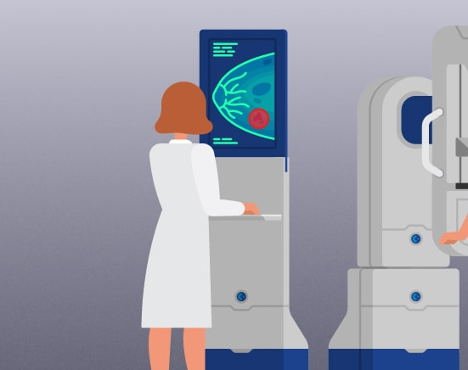
MAMMOGRAM CASE ANALYSIS
Meghashree Maddihally Nagoji

Slide 2
SIGNIFICANCE
Approximately $15.5 million mammograms ordered in year 2014
Approximately $926 spent on one screening mammogram
Detection at early stage is crucial
Efficient processes can encourage more women to take these tests

Slide 3


PROBLEMS
Staff Shortage – Increased workload
Missing & erroneous patient information
Staff coordination
Software delays
Parking & Navigation
Housekeeping responsibilities on radiologists

Slide 4
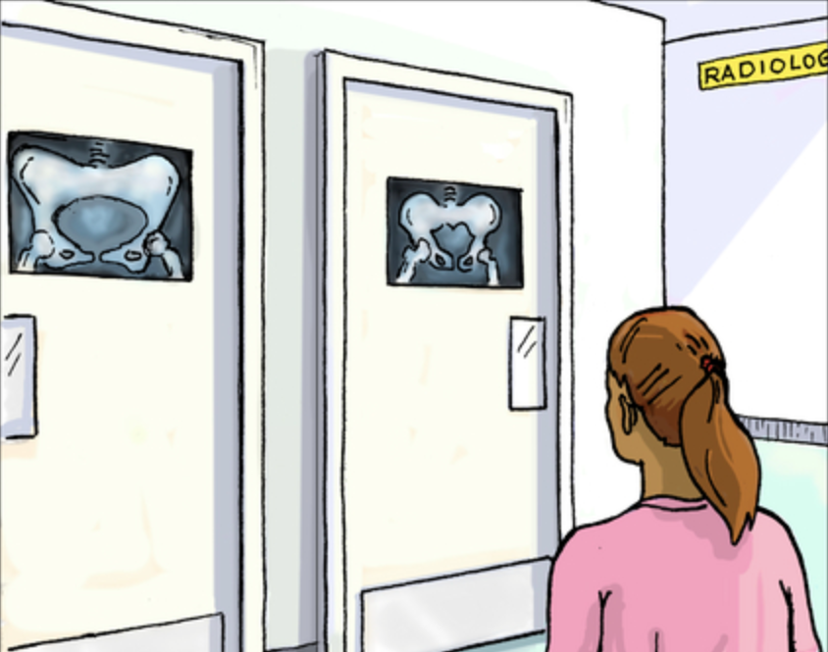
RECOMMENDATIONS
Clear navigation signs
Make patients kiosk-eligible
Make sure prescriptions are received beforehand
Upgrade report writing software and network infrastructure
Proper training of staff for the usage of new software systems
Additional staffing
Accommodate third ultrasound machine
Centralized database

Slide 5

THANK YOU

